Slide 1
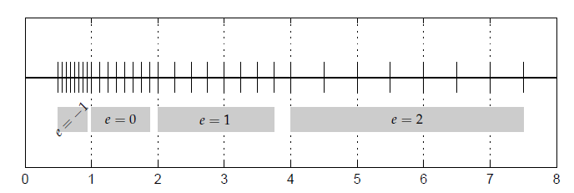
Chapter 1
Numbers, Problems and Algorithms

Slide 2
Objectives
Learn how numbers are represented in the computer
Examine consequences of floating point arithmetic
Begin to study numerical algorithms
Learn to identify when problems can cause numerical problems:
From subtraction of closely spaced numbers
From the problem itself: conditioning
From the numerical algorithm: stability

Slide 3

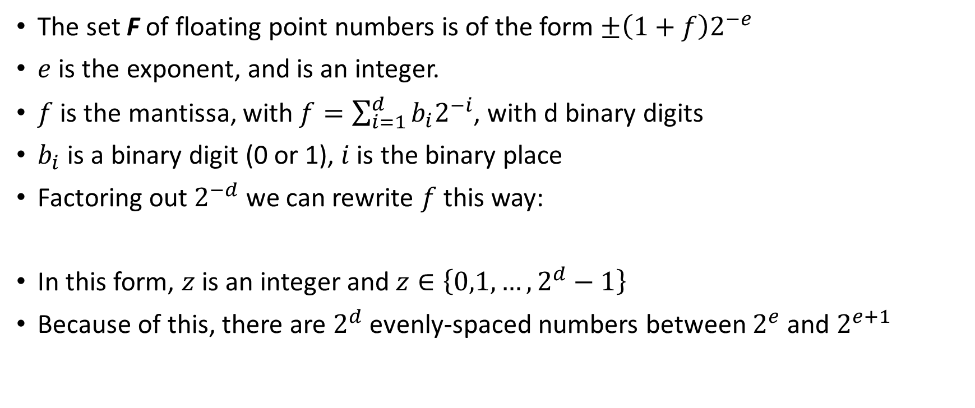
Floating point numbers
The set F of floating point numbers is of the form $±\left(1+f\right)2^{−e}$
$e$ is the exponent, and is an integer.
$f$ is the mantissa, with $f=\sum_{i=1}^{d}{b_{i}2^{−i}}$, with d binary digits
$b_{i}$ is a binary digit (0 or 1), $i$ is the binary place
Factoring out $2^{−d}$ we can rewrite $f$ this way:
In this form, $z$ is an integer and $z∈\left\{0,1,…,2^{d}−1\right\}$
Because of this, there are $2^{d}$ evenly-spaced numbers between $2^{e}$ and $2^{e+1}$

Slide 4

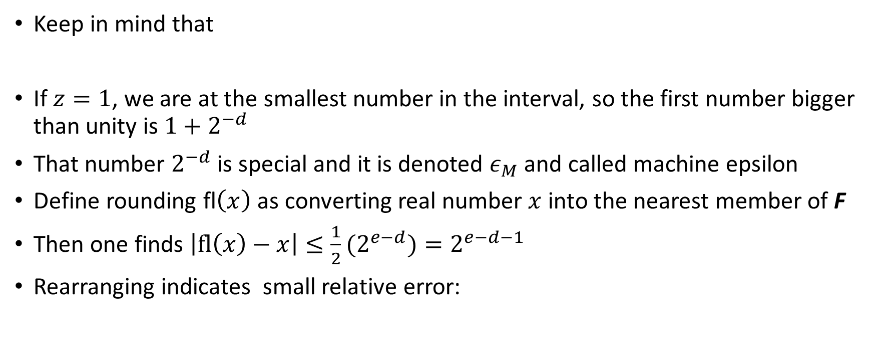
Properties of F
Keep in mind that
If $z=1$, we are at the smallest number in the interval, so the first number bigger than unity is $1+2^{−d}$
That number $2^{−d}$ is special and it is denoted $ε_{M}$ and called machine epsilon
Define rounding fl$\left(x\right)$ as converting real number $x$ into the nearest member of F
Then one finds $\left|fl\left(x\right)−x\right|≤\frac{1}{2}{(2}^{e−d})=2^{e−d−1}$
Rearranging indicates small relative error:

Slide 5


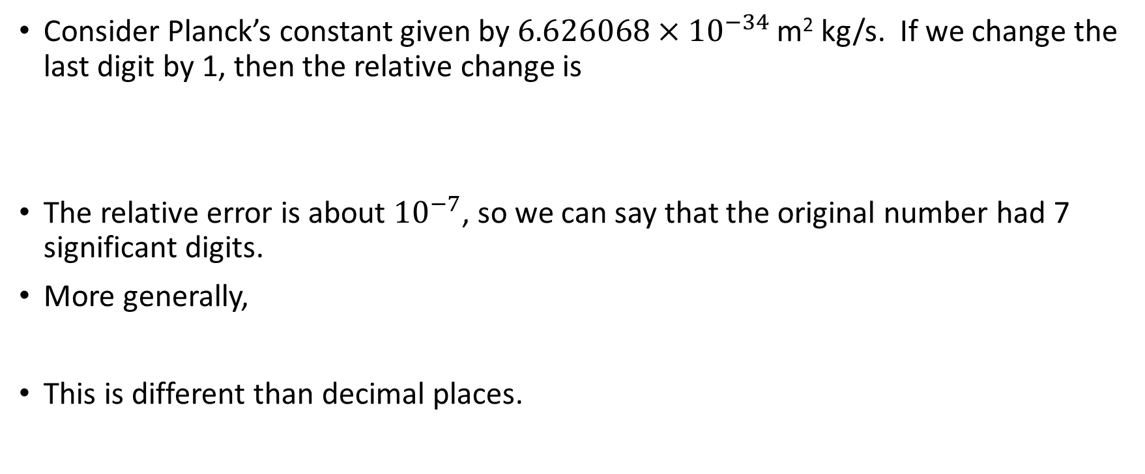
Scientific notation, significant digits
Consider Planck’s constant given by $6.626068×{10}^{−34}$ m² kg/s. If we change the last digit by 1, then the relative change is
The relative error is about ${10}^{−7}$, so we can say that the original number had 7 significant digits.
More generally,
This is different than decimal places.

Slide 6
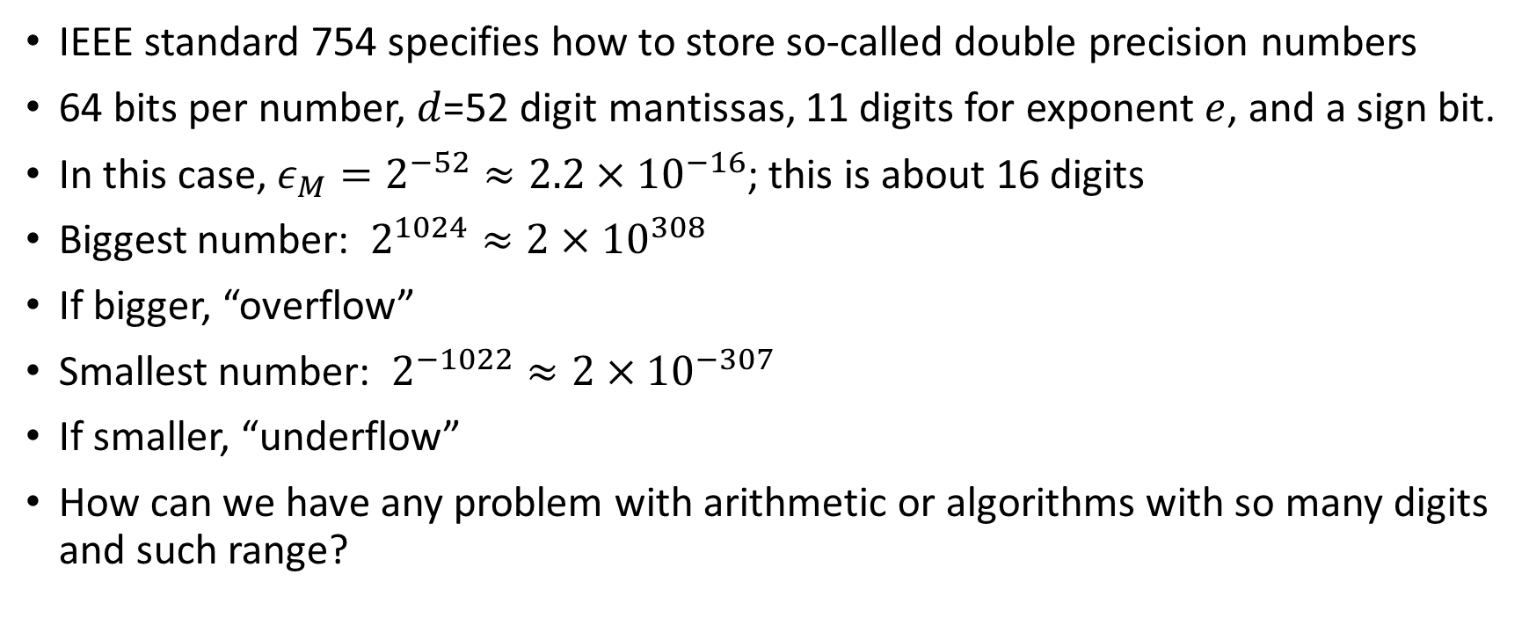
Double precision numbers
IEEE standard 754 specifies how to store so-called double precision numbers
64 bits per number, $d$=52 digit mantissas, 11 digits for exponent $e$, and a sign bit.
In this case, $ε_{M}=2^{−52}≈{2.2×10}^{−16}$; this is about 16 digits
Biggest number: $2^{1024}≈{2×10}^{308}$
If bigger, “overflow”
Smallest number: $2^{−1022}≈{2×10}^{−307}$
If smaller, “underflow”
How can we have any problem with arithmetic or algorithms with so many digits and such range?

Slide 7

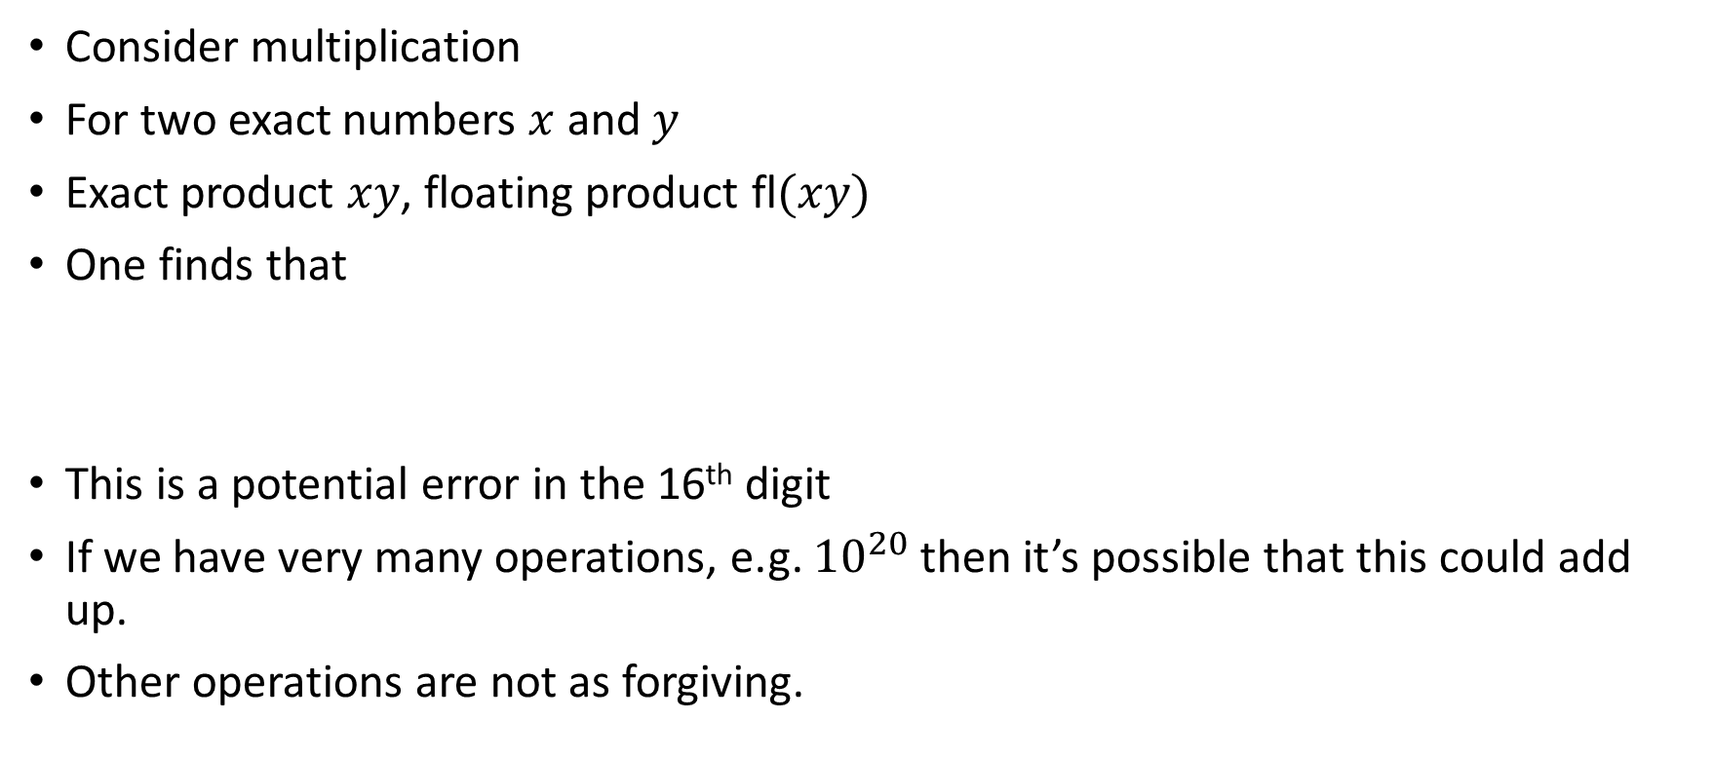
Floating point arithmetic
Consider multiplication
For two exact numbers $x$ and $y$
Exact product $xy$, floating product fl$(xy)$
One finds that
This is a potential error in the 16th digit
If we have very many operations, e.g. ${10}^{20}$ then it’s possible that this could add up.
Other operations are not as forgiving.

Slide 8

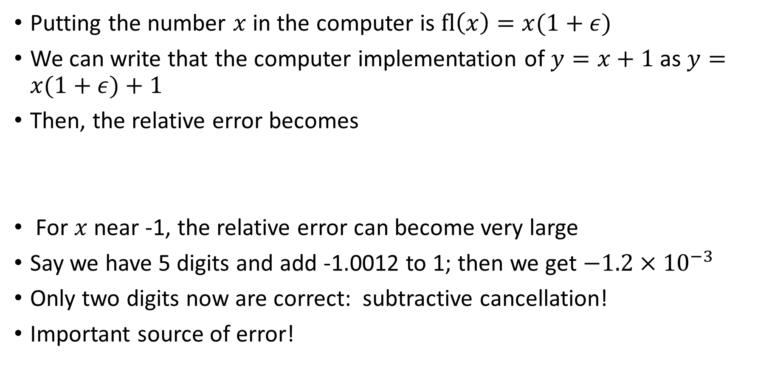
Problems and condition numbers
Putting the number $x$ in the computer is $fl\left(x\right)=x(1+ε)$
We can write that the computer implementation of $y=x+1$ as $y=x(1+ε)+1$
Then, the relative error becomes
For $x$ near -1, the relative error can become very large
Say we have 5 digits and add -1.0012 to 1; then we get $−1.2×{10}^{−3}$
Only two digits now are correct: subtractive cancellation!
Important source of error!

Slide 9


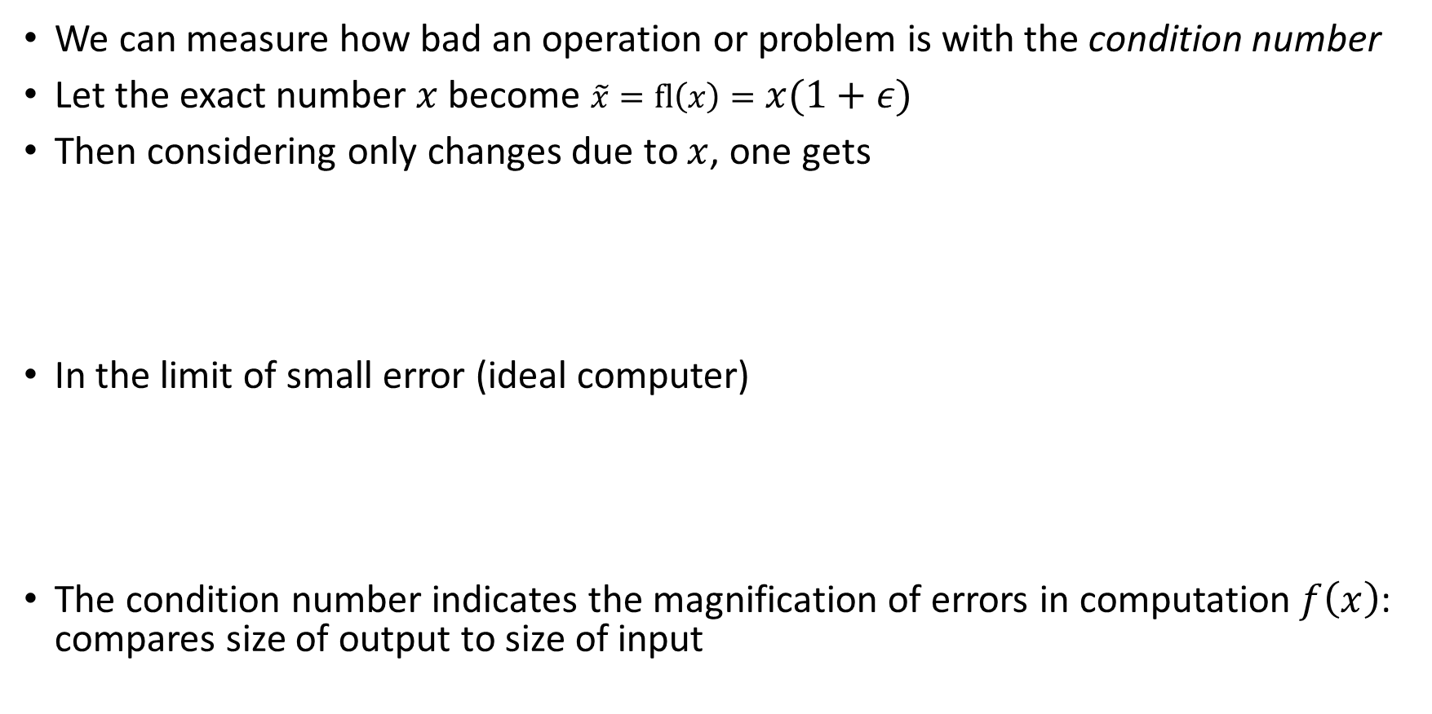
Condition numbers
We can measure how bad an operation or problem is with the condition number
Let the exact number $x$ become $\tilde{x}=fl\left(x\right)=x(1+ε)$
Then considering only changes due to $x$, one gets
In the limit of small error (ideal computer)
The condition number indicates the magnification of errors in computation $f\left(x\right)$: compares size of output to size of input

Slide 10



Condition number examples
Example: Return to addition, and consider $f\left(x\right)=x−c$
(Before, we had $c=−1$)
Use
Applying the formula,
The condition number is large when $x≈c$; conditioning is poor there

Slide 11



Condition number examples
Example: Multiplication by constant c, $f\left(x\right)=cx$.
Then
No magnification of error!
Example: $f\left(x\right)=cos⁡(x)$:
The condition number is large when $x=aπ/2$, where $a$ is an odd integer

Slide 12



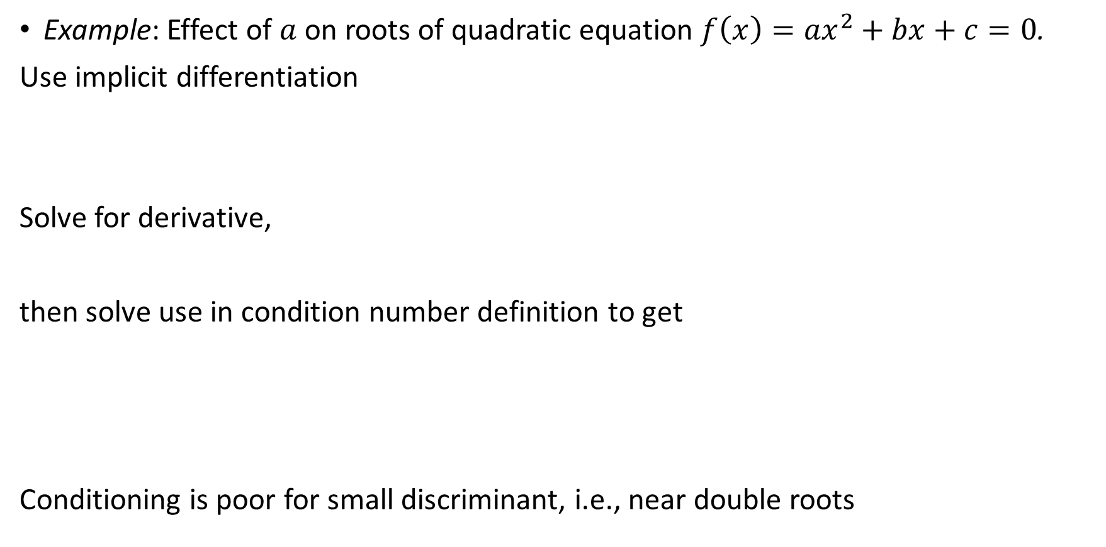
Condition number examples
Example: Effect of $a$ on roots of quadratic equation $f\left(x\right)={ax}^{2}+bx+c=0$.
Use implicit differentiation
Solve for derivative,
then solve use in condition number definition to get
Conditioning is poor for small discriminant, i.e., near double roots

Slide 13


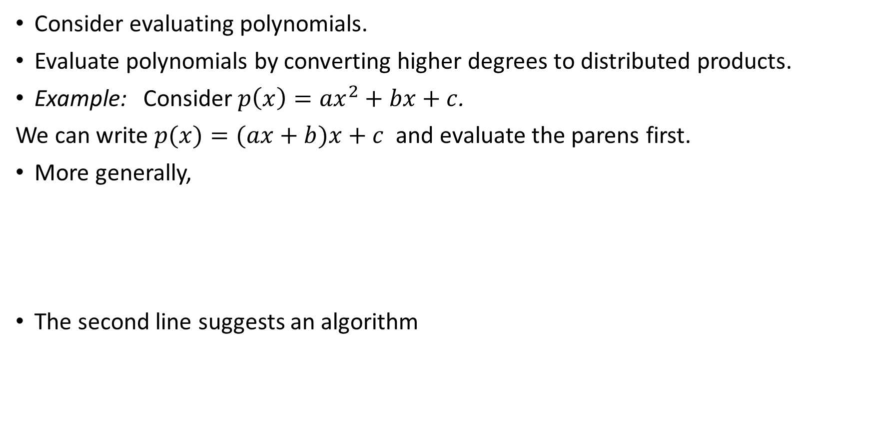
Algorithms
Consider evaluating polynomials.
Evaluate polynomials by converting higher degrees to distributed products.
Example: Consider$p\left(x\right)={ax}^{2}+bx+c$.
We can write $p(x)=(ax+b)x+c$ and evaluate the parens first.
More generally,
The second line suggests an algorithm

Slide 14
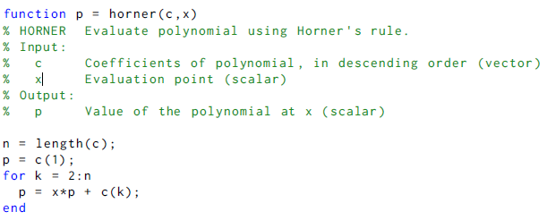
Horner’s algorithm

Slide 15
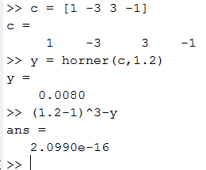
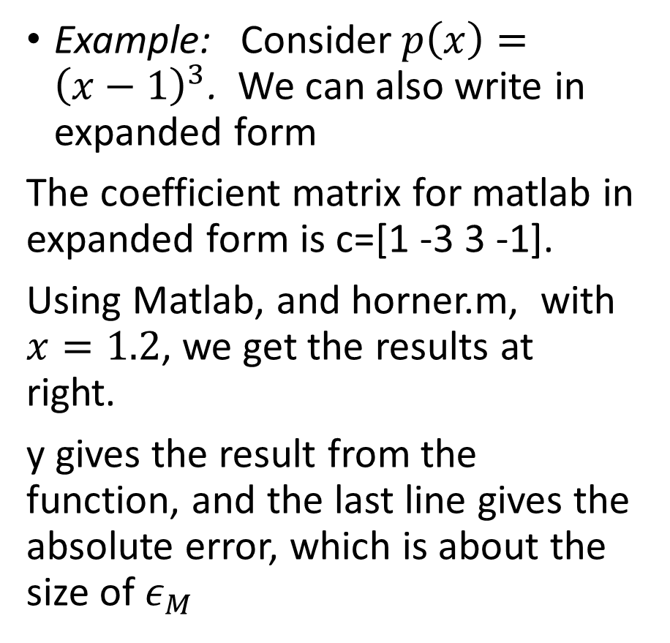
Horner’s algorithm
Example: Consider$p\left(x\right)={\left(x−1\right)}^{3}$. We can also write in expanded form
The coefficient matrix for matlab in expanded form is c=[1 -3 3 -1].
Using Matlab, and horner.m, with $x=1.2$, we get the results at right.
y gives the result from the function, and the last line gives the absolute error, which is about the size of $ε_{M}$

Slide 16
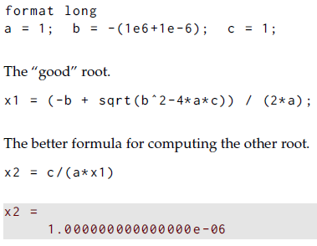


Stability
Consider solving the quadratic formula again ${ar}^{2}+br+c=0$
It the standard formula is used with $a=c=1$ and $b=−\left({10}^{6}+{10}^{−6}\right)$, the exact answer is roots at ${r_{1}=10}^{6}$ and ${r_{2}=10}^{−6}$
Numerically, the first root is exact in Matlab, but the second root has only 5 correct digits!
We could do better by using the
following formula for $r_{1}$
and then $r_{2}=(c/a)/r$ will get the answers
to many digits

Slide 17
Stability: quadratic equation
First computation failed because numerator was difference of closely spaced numbers, which caused loss of significance (from subtractive cancellation).
The loss of significance caused a much larger relative error than one may expect.
Avoid the problem by using different formulas to calculate roots.
Other situations benefit from changing the approach.

Slide 18
Stability: approximate exponential integral
Example from Moler for approximating the exponential integral.
Use integration by parts to get recursive formula.
Using the formula one way magnifies error so that approximation becomes negative (it can’t) in just a few iterations. That way is unstable because it magnifies roundoff error.
Rewriting the formula and using it differently minimizes error at each step and rapidly approaches the desired results: that approach is stable.
We have to choose or design algorithms that are stable against roundoff error.

Slide 19
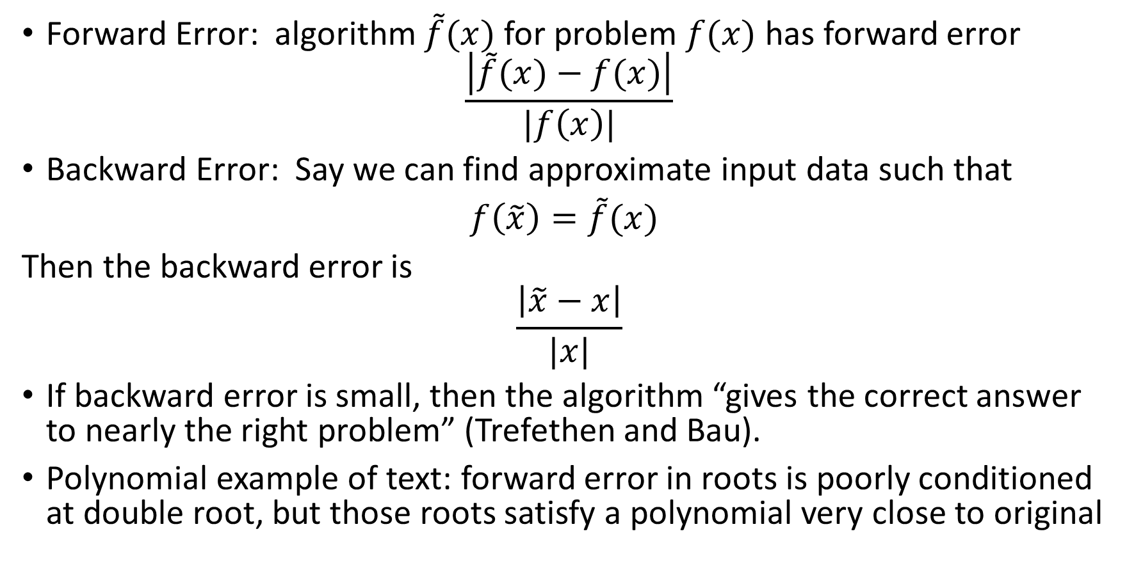
Stability and backward error
Forward Error: algorithm $\tilde{f}(x)$ for problem $f(x)$ has forward error
$$\frac{\left|\tilde{f}(x)−f(x)\right|}{|f\left(x\right)|}$$
Backward Error: Say we can find approximate input data such that
$f\left(\tilde{x}\right)=\tilde{f}(x)$
Then the backward error is
$$\frac{\left|\tilde{x}−x\right|}{|x|}$$
If backward error is small, then the algorithm “gives the correct answer to nearly the right problem” (Trefethen and Bau).
Polynomial example of text: forward error in roots is poorly conditioned at double root, but those roots satisfy a polynomial very close to original

Slide 20
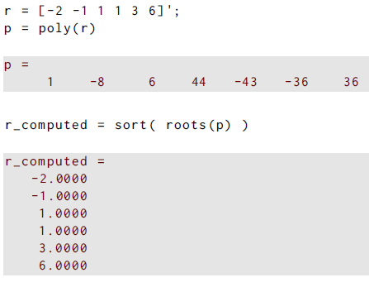
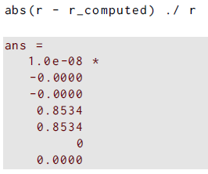
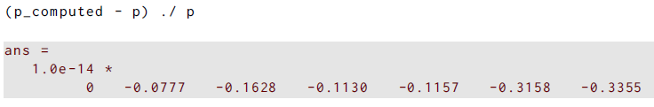
Stability and backward error
Compute roots of 6th degree polynomial
One pair is a double root
Those roots have large forward error
Using the roots to go backward and get coefficents gives very close polynomial

Slide 21
Stability and backward error
Small backward error is the best we can hope in a finite precision environment.
Showing small backward error implies stability: the algorithm doesn’t magnify error. This is the polynomial example.
But, stability doesn’t imply small backward error: subtraction is an example.

